Slide 1

No (available) data, no paper
Better to start with the end in mind
Niels Geudens, PhD Data steward at VIB/ELIXIR Belgium
Research Data Management: your ally on the way to your publication
May 16th 2025, Gent

Slide 2

Outline
What is Research Data Management (RDM)
Why do we do RDM
Open data VS FAIR data
What are the benefits of good RDM
During the project
After the project
How to approach RDM starting with "the end" (FAIR metadata) in mind
ELIXIR (Belgium) resources for RDM

Slide 3
What is Research Data Management (RDM)?
Let’s write a definition
use pens and papers

Slide 4




Research Data Management (RDM)
All actions necessary to ensure that research data is
Easy to find
(for humans and machines)
Well described
Secure
Reusable
Notes:
RDM is the practice of making decisions about your digital and physical research data, and then putting those decisions into action.

Slide 5
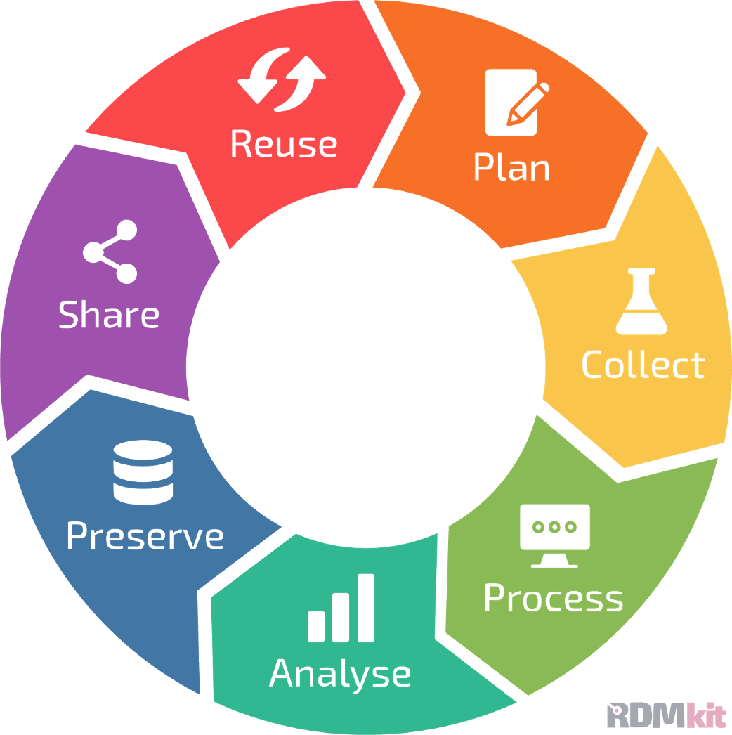
Data life cycle to describe RDM
All actions necessary to ensure that research data is
Data life cycle: RDM stages
Easy to find
(for humans and machines)
Well described
Secure
Reusable
https://rdmkit.elixir-europe.org

Slide 6
Why do we do RDM?
Let’s write possible reasons
use pens and papers

Slide 7
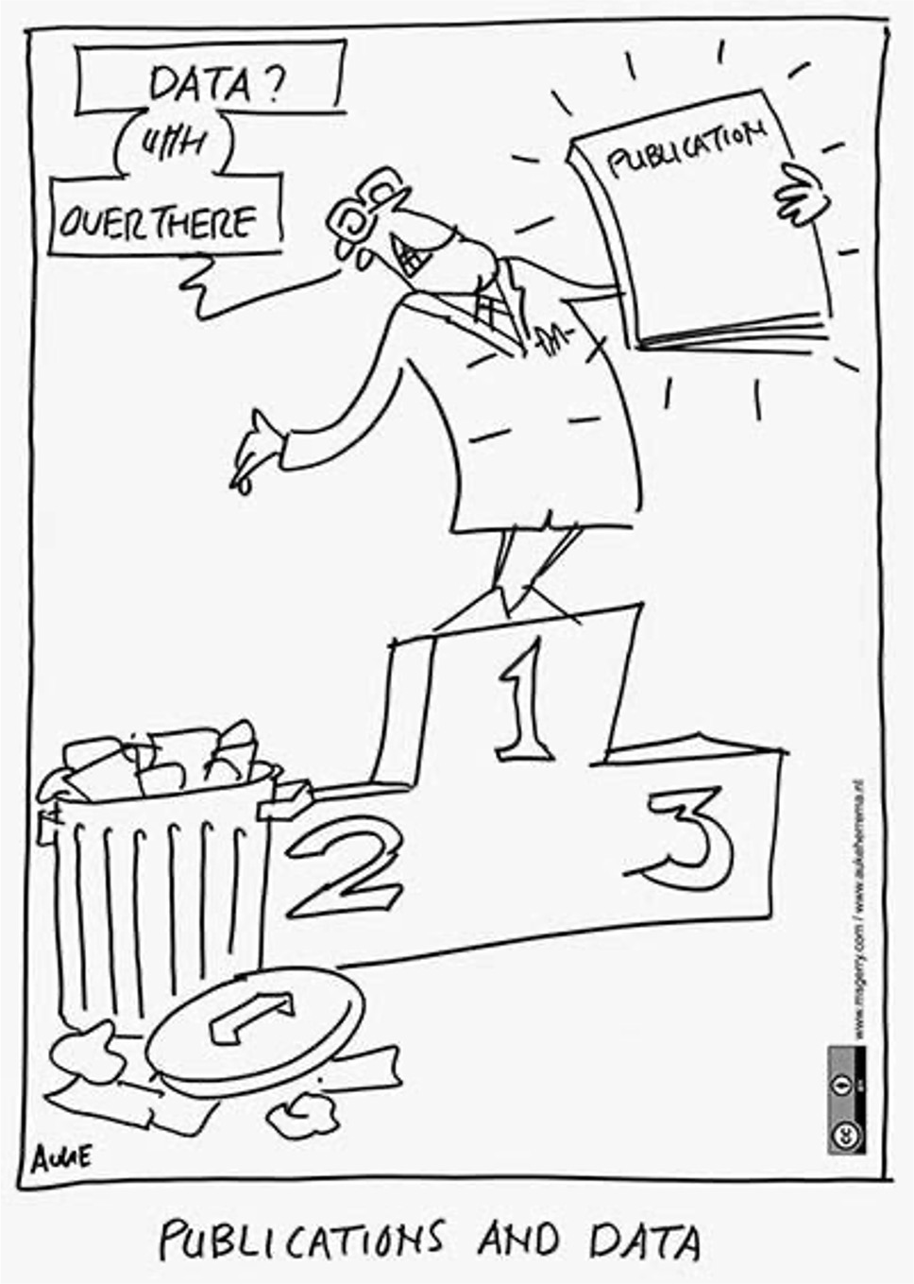
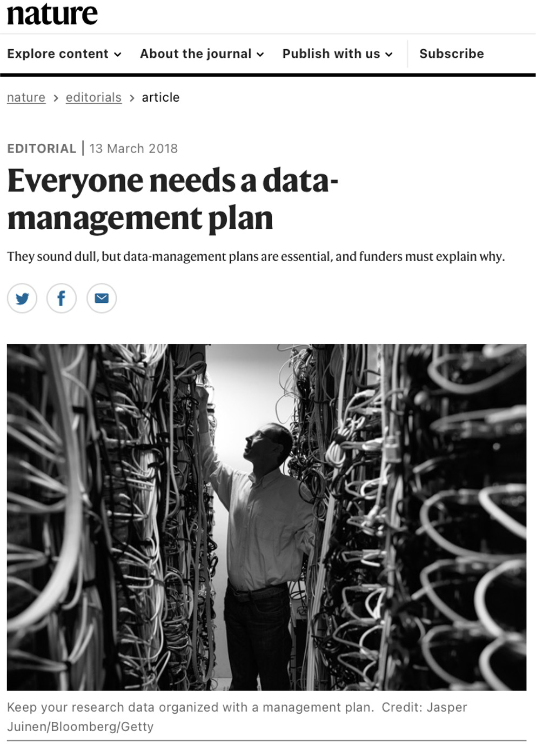
Funders' and journals’ data policy: focus on data
Before
After (now)
RDA Plenary Cartoons by Auke Herrema in CC-BY
doi: https://doi.org/10.1038/d41586-018-03065-z
Notes:
Also for policy!

Slide 8
Funders requirements:
Data management plan (DMP)
Data availability policy:
“as open as possible, as closed as necessary”

Slide 9



Data management plan (DMP)
Sessions:
“Planning for efficiency” session
What’s “data” in DMP ? How are you going to manage it during and after the project?
Digital or digitalised information
Physical materials
Software, other reseach output
Notes:
Research data is essentially anything that has helped you to form the basis of your research output

Slide 10
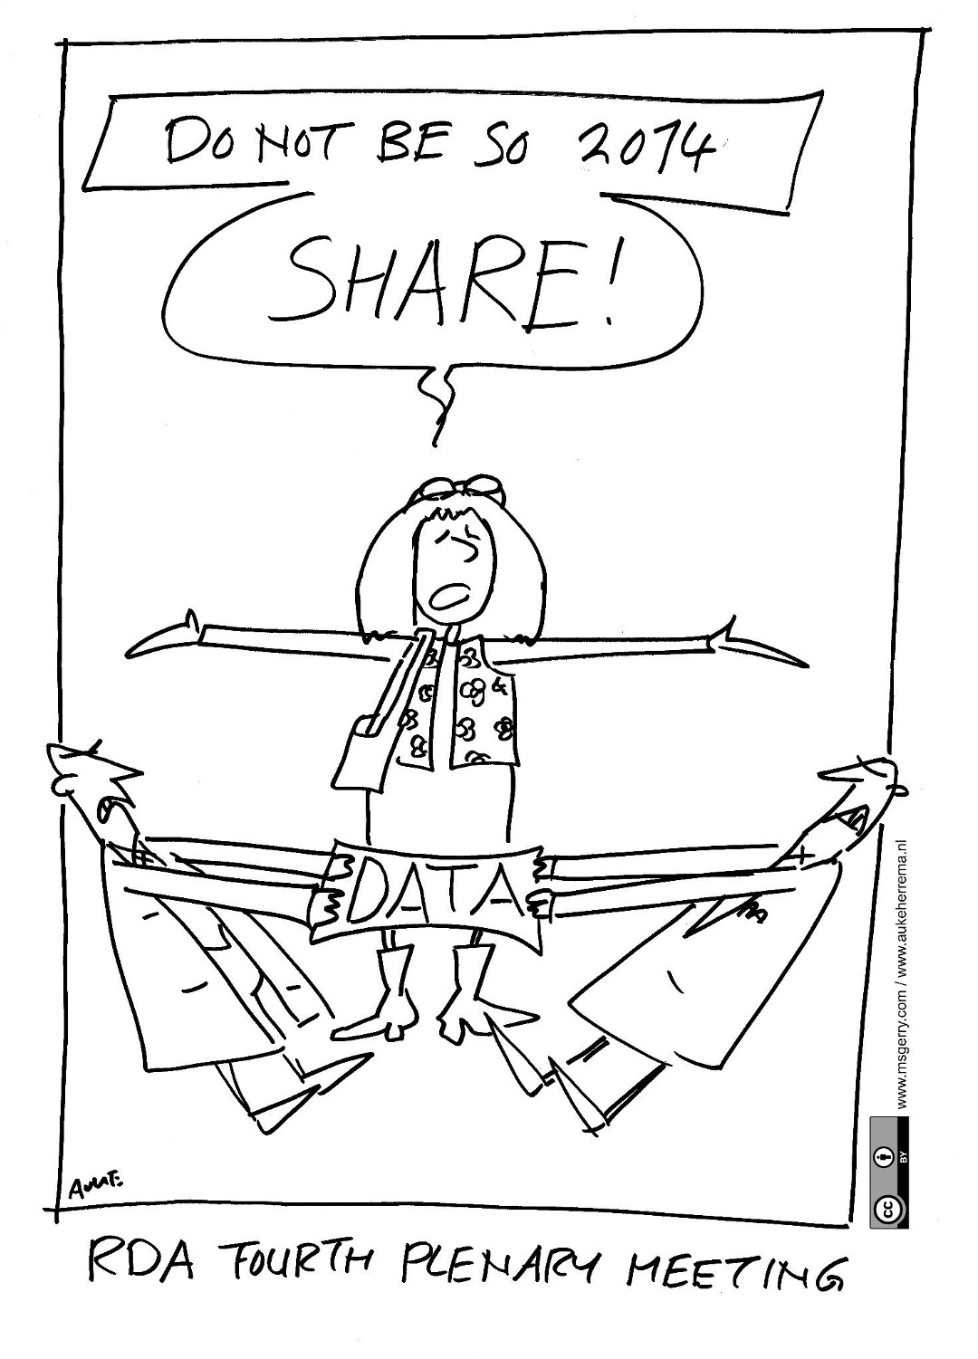
Data availability policy: as open as possible, as closed as necessary
Sessions:
“Ethical and legal constraints on the sharing of personal data”
Open Definition
“Open means anyone can freely access, use, modify, and share for any purpose (subject, at most, to requirements that preserve provenance and openness).
From Open Definition
From http://aukeherrema.nl in CC-BY

Slide 11
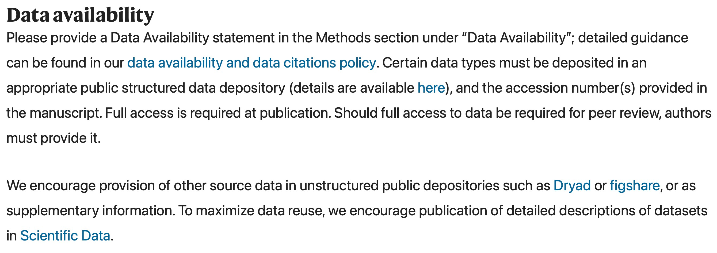
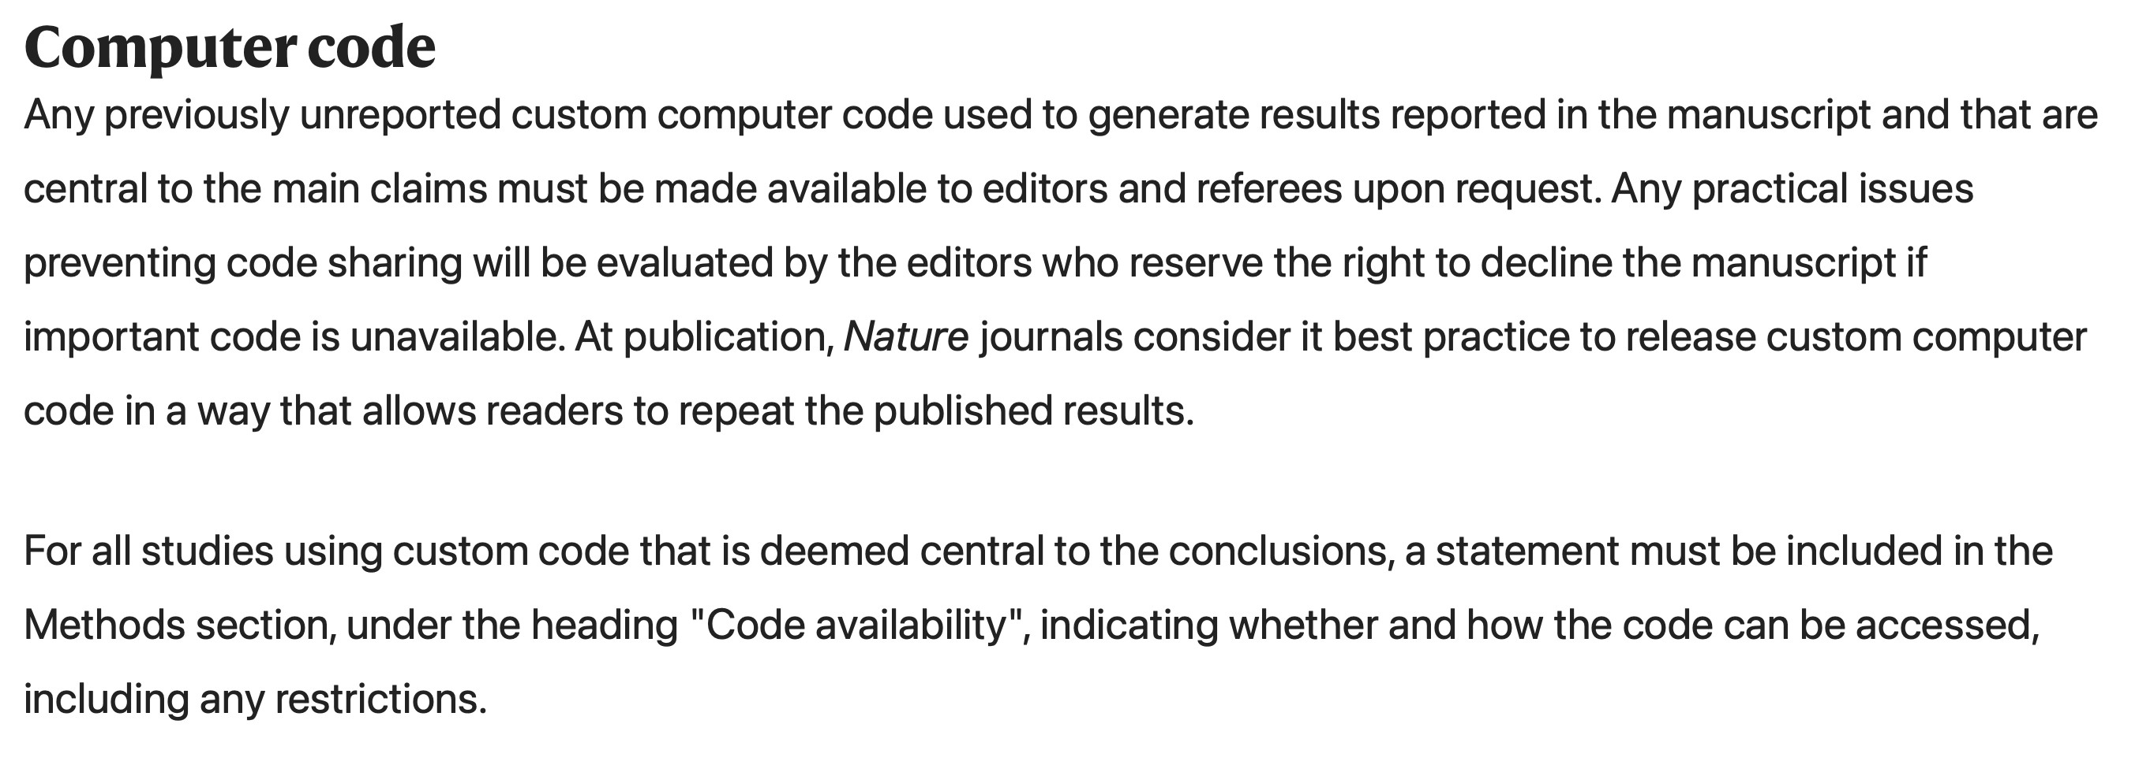
Journals: no available data, no paper
https://www.nature.com/nature/for-authors/initial-submission

Slide 12
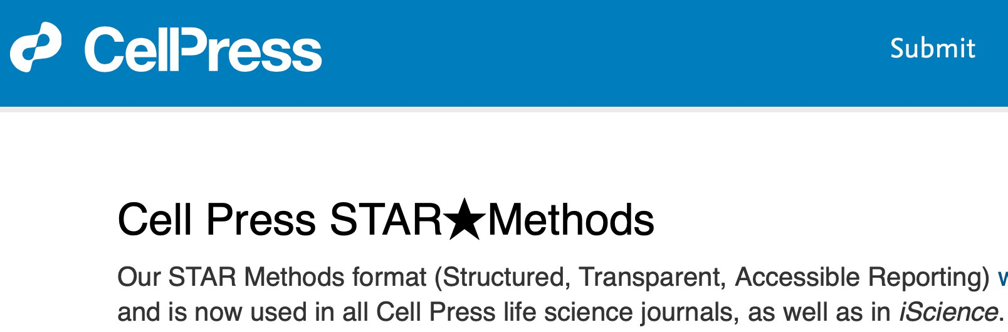
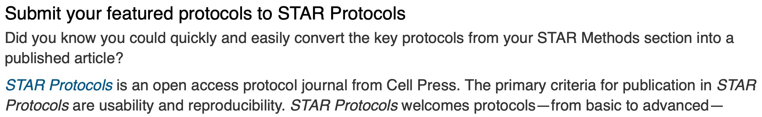
Journals: no available data, no paper
https://www.cell.com/star-authors-guide

Slide 13
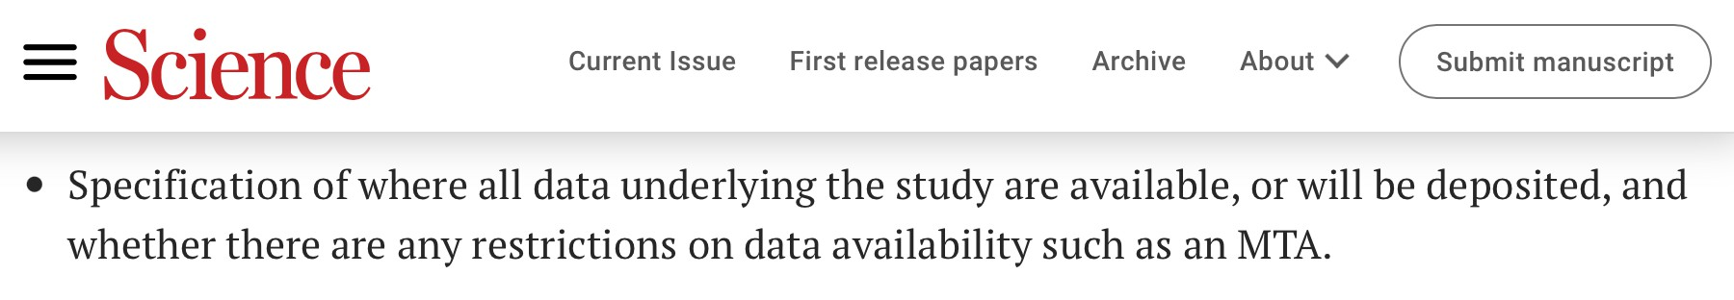
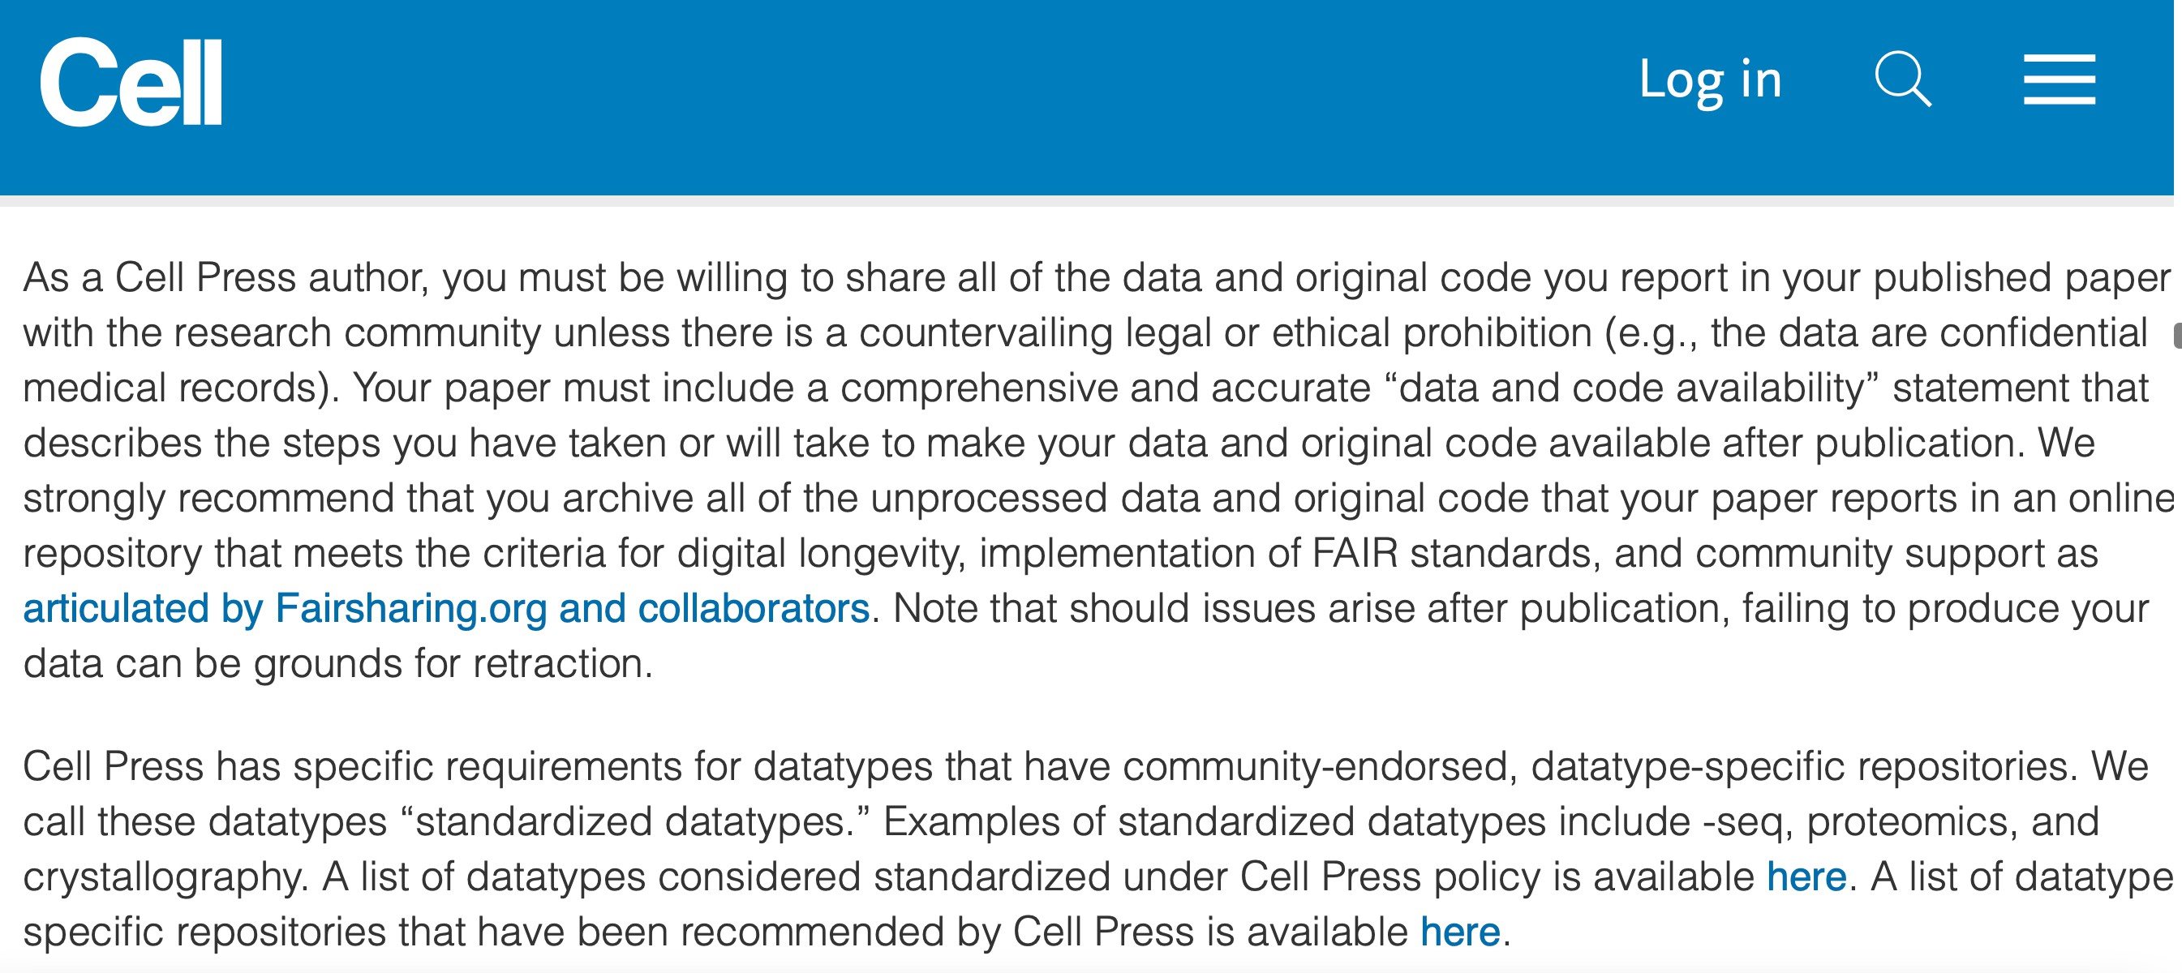
Journals request FAIR data
https://www.science.org/content/page/science-information-authors
FAIR?
https://www.cell.com/cell/authors

Slide 14
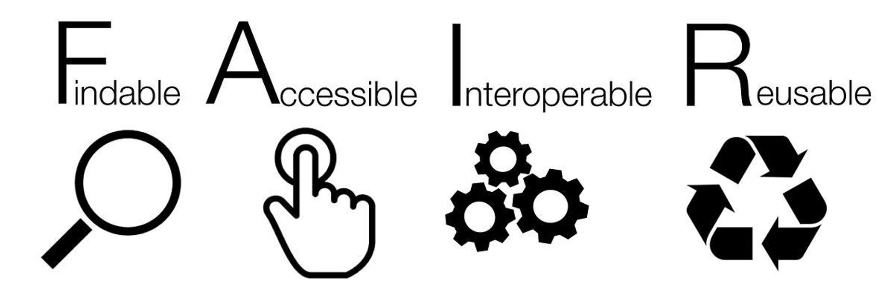
FAIR principles for data and metadata
https://www.go-fair.org/fair-principles/
Sangya Pundir, CC BY-SA 4.0
Metadata
keywords
identifiers
machine-actionable (SEO, etc)
Access procedure
Standards
Ontologies
For humans and machines
Documentation
Licence
e.g., DAC
authentication, identification
…
Notes:
Discretionary access control

Slide 15
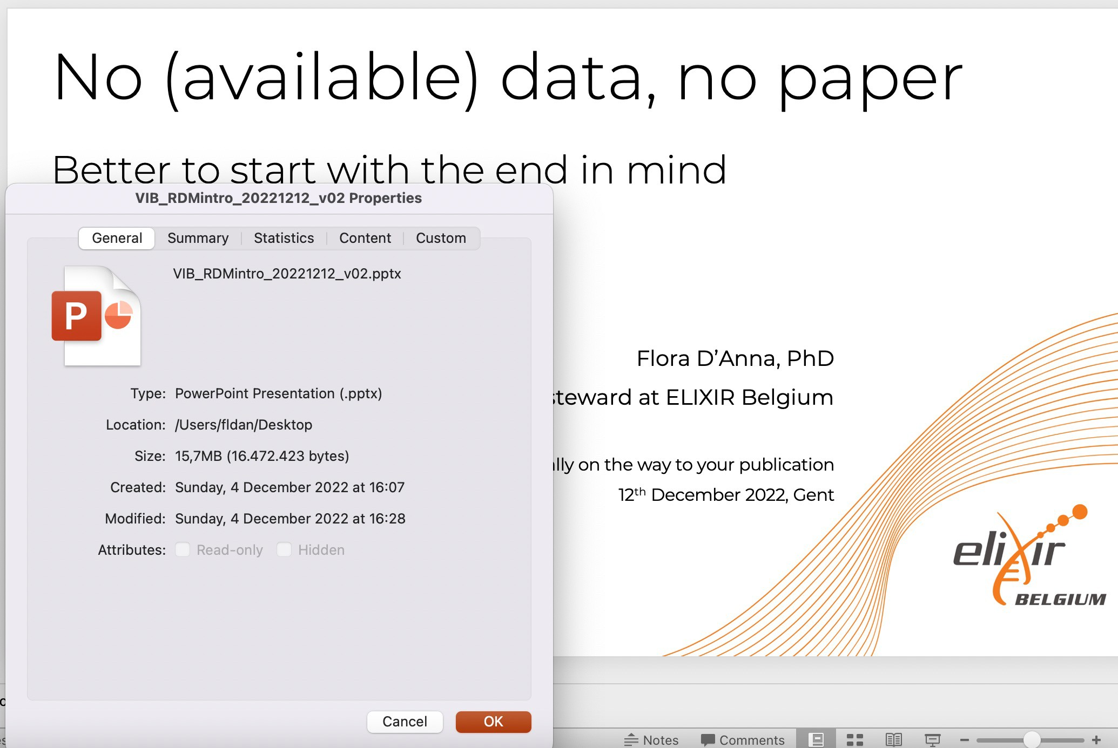
Metadata is highly structured documentation
Example 1: machine-actionable metadata of a PowerPoint file
Data
Metadata fields
Metadata

Slide 16
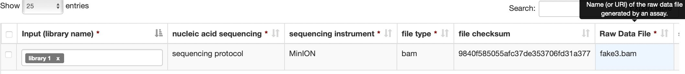

Example 2: metadata of a DNA sequencing experiment
Metadata fields or attributes
Metadata
Data
From https://datahub.test.elixir-belgium.org
WARNING:
Data VS Metadata
The difference is often dependent on the research question
What is considered metadata by someone can be used as data by others in a different context

Slide 17
Example 3: metadata for a study about the most used file type in sequencing
Metadata fields or attributes
Metadata
Data
From https://datahub.test.elixir-belgium.org
WARNING:
Data VS Metadata
The difference is often dependent on the research question
What is considered metadata by someone can be used as data by others in a different context

Slide 18
FAIR principles for data and metadata: explained
https://www.go-fair.org/fair-principles/
Sangya Pundir, CC BY-SA 4.0
Metadata
keywords
identifiers
machine-actionable (SEO, etc)
Access procedure
Standards
Ontologies
For humans and machines
Documentation
Licence
e.g., DAC
authentication, identification
…

Slide 19

Findable
Your (meta)data can be discovered by others
Where? When?
Searchable resources such as
During the project
After the end of the project
search engines
databases or repositories
systems for shared storage, etc
registries of metadata
By whom?
How?
Collaborators, colleagues
Reviewers
Other scientists, society at large
Registries, web crawler
Machine-actionable* metadata (SEO, etc)
Machine-actionable keywords
Unique and persistent identifiers
*Machine-actionable: following standards for machines

Slide 20

Sharing data – Repositories
Sessions:
“Data publication 101” session
Repositories or deposition databases
Machine-actionable metadata (SEO, etc)
Machine-actionable keywords
Unique and persistent identifiers

Slide 21



Sharing data – Appropriate restrictions
Sessions:
“Ethical and legal constraints on the sharing of personal data”
“A closer look at the repositories world”
Ethical and legal constrains
Repositories with restricted access

Slide 22

Accessible
Your (meta)data can be made available to others
Where? When?
Databases or repositories
Systems for shared storage, etc
Registries for metadata
During the project
After the end of the project
To whom?
People and/or machines with the right access permission or authorization
How?
Open, free, universally implementable standard protocol to retrive the (meta)data (e.g. via a “link”)
It could include authentication and/or authorization protocol
Data Access Committee (DAC), etc

Slide 23


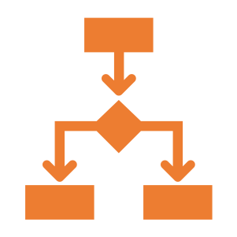

Interoperable
Humans and machines can exchange, interpret and integrate each other’s (meta)data
Non-proprietary file formats that are data exchange formats, for structured data (e.g. JSON, XML, CSV, TSV, FASTQ, FASTA etc.).
(Meta)Data schema defining the relations, such as hierarchy, of the elements that constitute the (meta)data model or structure.
Controlled vocabularies or ontologies to convey unambiguous meaning or semantics (e.g. EFO, OBI, Gene Ontology).

Slide 24
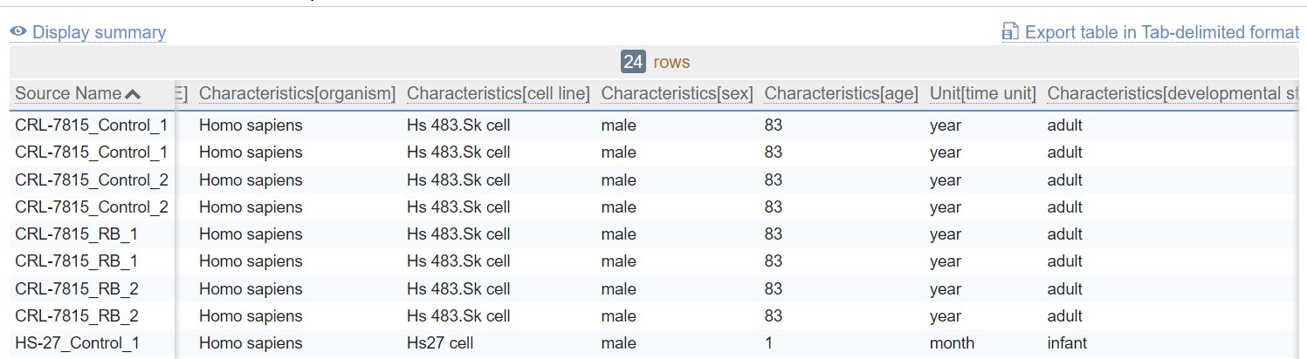
Interoperable: file formats for exchange of structured data
https://www.ebi.ac.uk/arrayexpress/experiments/E-MTAB-11728/samples/
CSV, TSV
Most machines (computers, software) read and open CSV or TSV by “arranging” the information in columns and rows
Easy to readable for humans as well

Slide 25
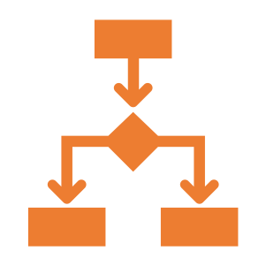
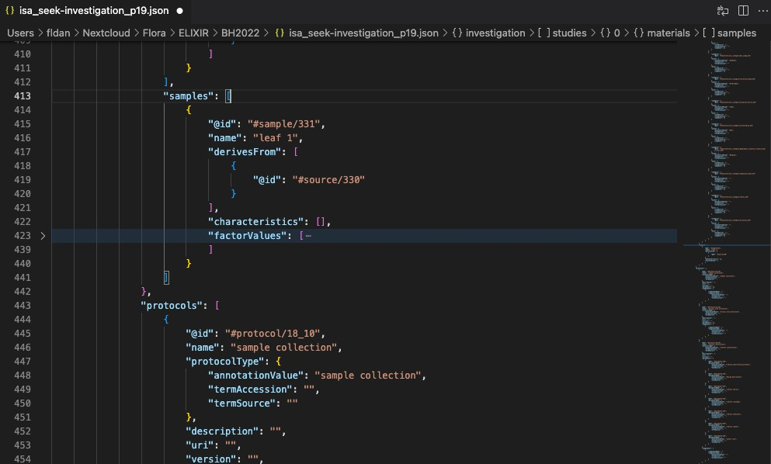
Interoperable: hierarchically structured metadata model
ISA-JSON
Most machines (computers, software) read and open JSON
key : value
Not easy to read for humans
Johnson D, et al. ISA API: An open platform for interoperable life science experimental metadata. Gigascience. 2021 Sep 16;10(9):giab060. doi: 10.1093/gigascience/giab060.

Slide 26

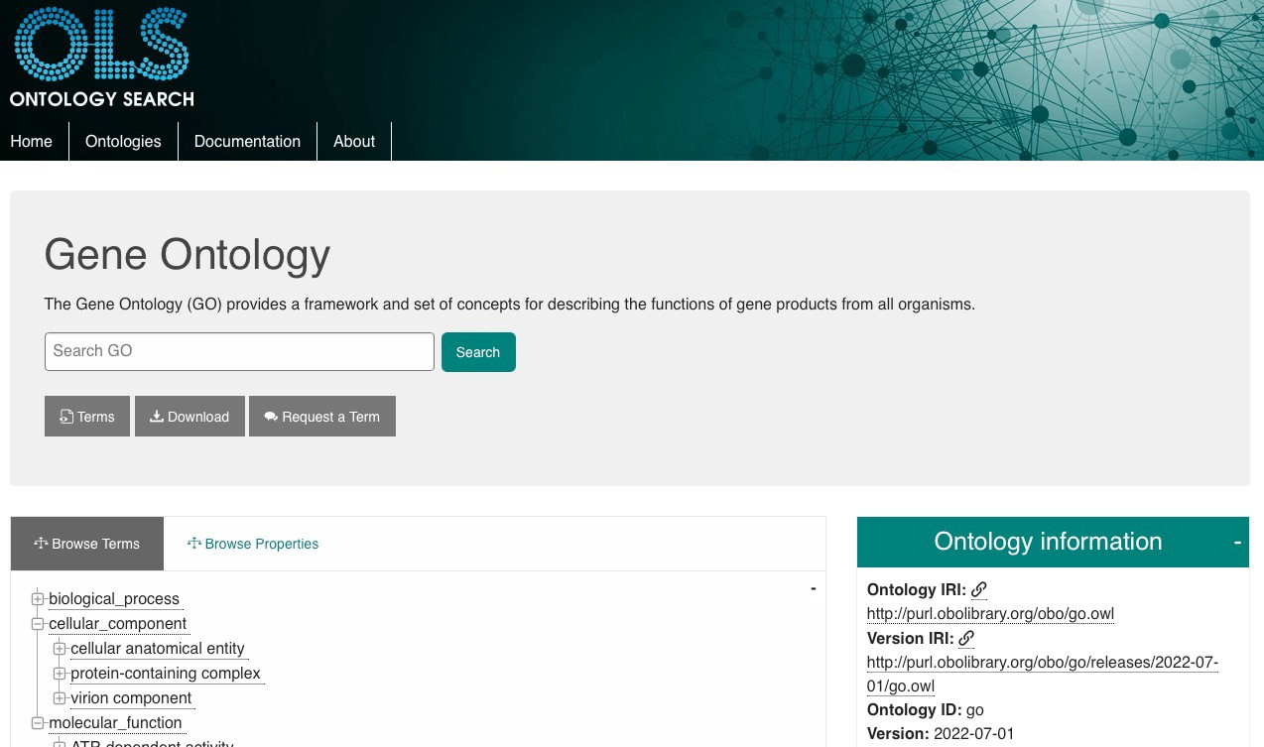




Interoperability: controlled vocabularies or ontologies to convey unambiguous meaning or semantics
Ontology term:
definition
identifier
NCBI Taxonomy for mouse:
Taxonomy ID: 10090
More info at:
https://rdmkit.elixir-europe.org/metadata_management#how-do-you-find-appropriate-vocabularies-or-ontologies
https://faircookbook.elixir-europe.org/content/recipes/interoperability/introduction-terminologies-ontologies.html

Slide 27


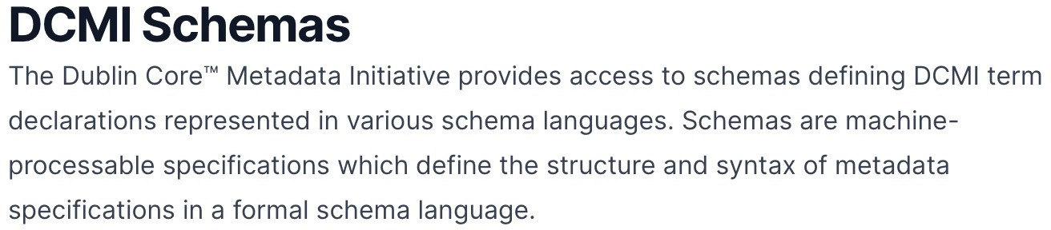
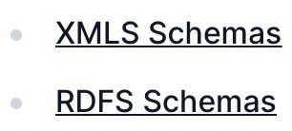
Interoperability: standards and standardization for humans and machines
Sessions:
“Organising and standardising research data that underpin your publication”
“Make writing easier: Document & describe your data”
Use of existing international or domain-specific standards
ISO STANDARDS for dates: 20220715 or 2022-07-15

Slide 28



Reusable
Your (meta)data can be reused by others
Data usage licence
Documentation and metadata (e.g., data provenance, etc)
README.txt

Slide 29

Documentation and metadata
Sessions:
“Organising and standardising research data that underpin your publication”
“Make writing easier: Document & describe your data”
Documentation is (unstructured) information about the data.
README.txt
Metadata is highly structured documentation.
Metadata.json

Slide 30
Data reuse
Sessions:
“Reusing data”
Where to find data to reuse
Permission to reuse for specific purpose
Data quality
How to handle versioning
How to cite
- …

Slide 31
Open vs. FAIR data: Open data is different from FAIR data
DATA
Open
FAIR
Restricted
Closed

Slide 32
What are the benefits of good RDM?
Let’s write possible reasons
use pens and papers

Slide 33
Benefits of good RDM (or FAIR data)
During the project
Reduce the risk of data loss
Less time (and money) spent
looking for unfindable data
redoing not documented experiments/analysis
Increase efficiency and smooth collaboration in a team (easier and faster way for sharing information)
More control over data access (who, when, how, etc.)
More clear documentation for people onboarding the team and by people leave the team
Easier data reuse (samples, raw data, scripts, analysis etc.)

Slide 34
Benefits of good RDM (or FAIR data)
After the project
Results are reproducible by others
Transparent and trustworthy data and science (and paper) among your peers
Higher impact in scientific community and possibly more citations
Integration of several data sources from different disciplines could lead to new discoveries
New discoveries at a lower cost by reusing high quality existing data
Less duplication of work

Slide 35
How to approach RDM starting with “the end” (FAIR metadata) in mind
Choose the right repositories for your data
Learn the requirements of the selected repositories
Start writing and applying your DMP document

Slide 36


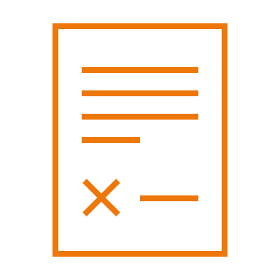
How to choose the right repositories for your data
Sessions:
“Ethical and legal constraints on the sharing of personal data”
“A closer look at the repositories world”
1. Ethical and legal issues
3. Consultation with experts
4. Access restrictions and/or reuse limitations
5. Appropriate repositories
2. Data availability requirements

Slide 37

Learn the requirements of the selected repositories
Sessions:
“Data publication 101” session
“Organising and standardising research data that underpin your publication”
“Make writing easier: Document & describe your data”
Reusing data
4. Documentation & metadata requirements
1. Data policies
2. File formats
3. Costs

Slide 38
Write and implement your DMP
Sessions:
“Planning for efficiency” session
What’s “data” in DMP ? How are you going to manage it during and after the project?
Digital or digitalised information
Physical materials
Software, other reseach output

Slide 39

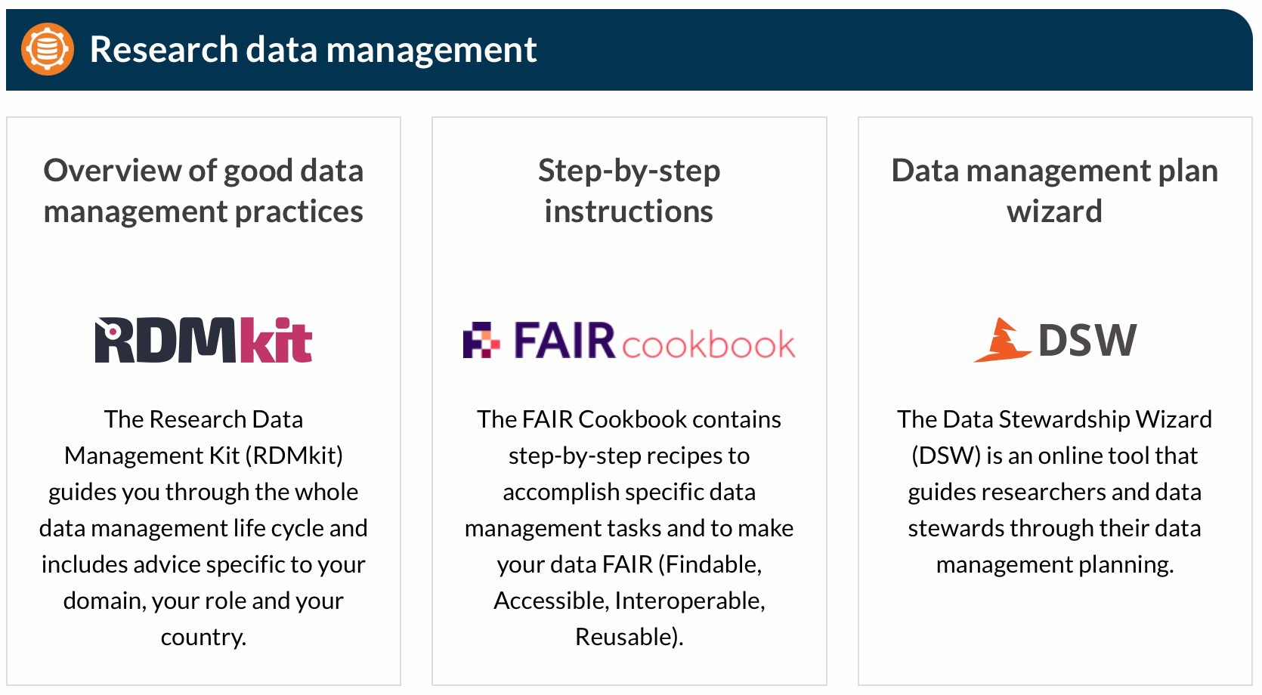

Useful resources for RDM best practices and guidelines
RDMkit: the research data management toolkit for life sciences by ELIXIR (https://elixir-europe.org)
https://rdmkit.elixir-europe.org
ELIXIR research data management guidelines and best practices (https://elixir-europe.org/what-we-offer/guidelines )
ELIXIR Belgium services for RDM (https://www.elixir- belgium.org/research_data_management)
RDM Guide by ELIXIR Belgium
https://rdm.elixir-belgium.org

Slide 40
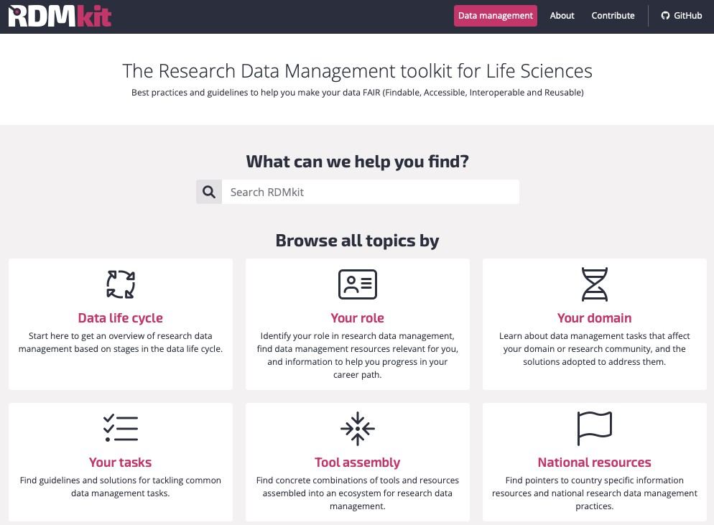
RDMkit: research data management best practices and guidelines for life sciences
https://rdmkit.elixir-europe.org

Slide 41
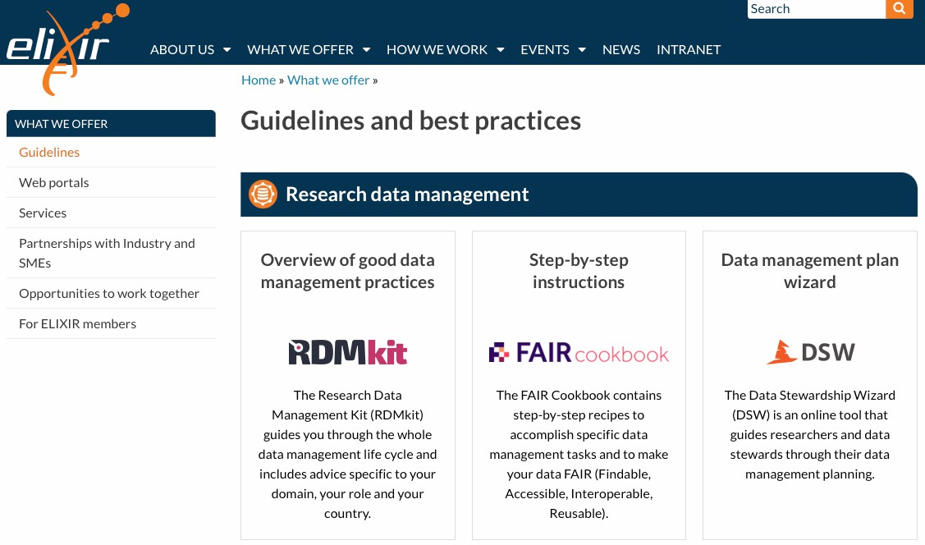
ELIXIR research data management guidelines and best practices
https://elixir-europe.org/what-we-offer/guidelines

Slide 42
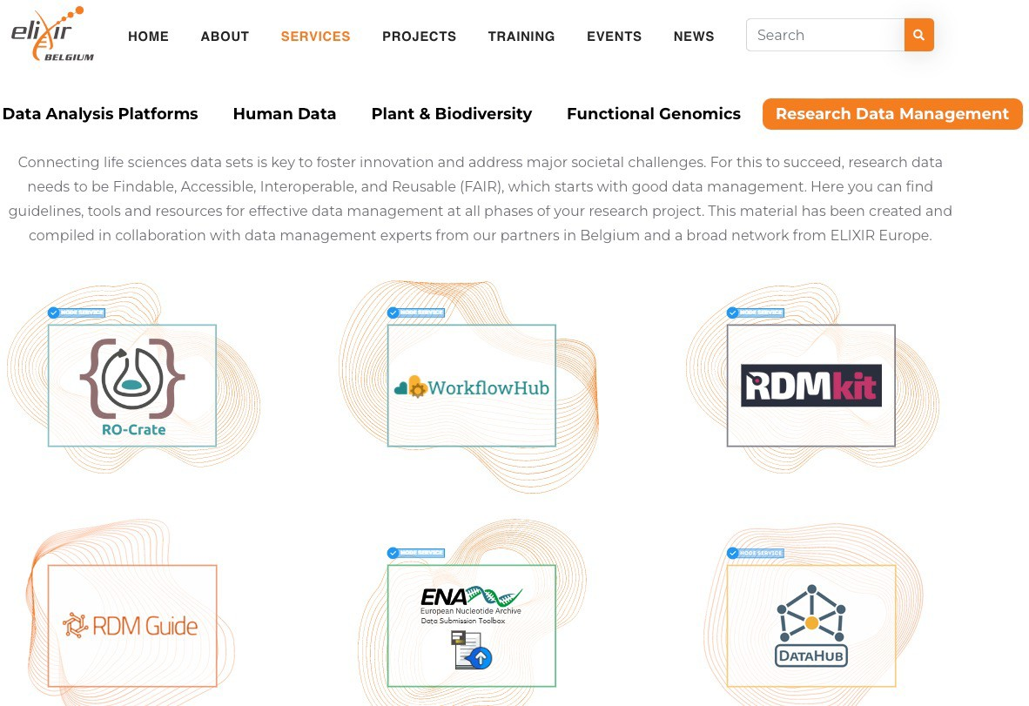
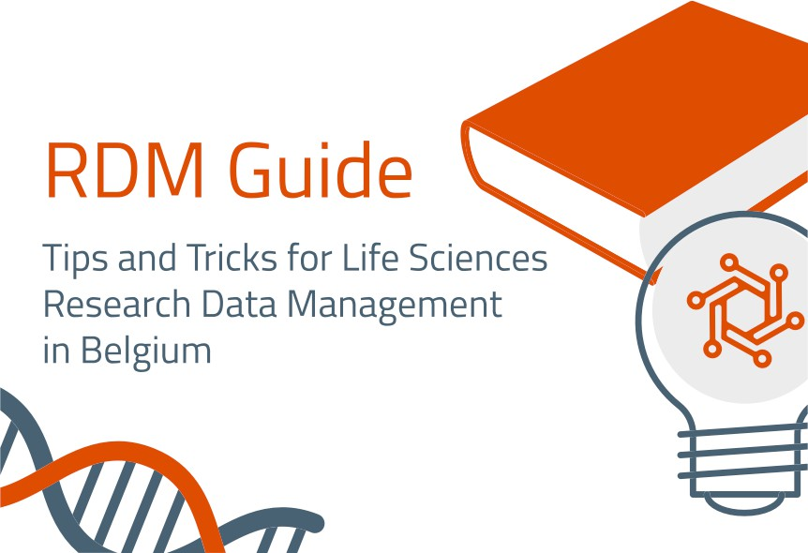
ELIXIR Belgium services for RDM – RDM Guide
https://www.elixir-belgium.org/services#term-25
https://rdm.elixir-belgium.org

Slide 43
Conclusions
RDM includes all tasks needed to make (meta)data well described, easy to find, secure and reusable
Funders and scientific journals require DMP, open and FAIR data
Open data is different from FAIR data
Benefits of good RDM for the research and the researchers
During the project
After the project
Starting your DMP and your research project with FAIR (meta)data in mind eases data publication
Use available resources for RDM in life sciences provided by ELIXIR (Belgium)

Slide 44
info@elixir-belgium.org
https://www.elixir-belgium.org
This work is licensed under the Creative Commons Attribution 4.0 International License. To view a copy of this license, visit http://creativecommons.org/licenses/by/4.0/.

